Slide 1

STUDENT DETAILS
1)NAME- RUPAYAN SAHA
2)SkillsBuild Email ID- 12b19rupayansaha@gmail.com
3)COLLEGE NAME- UNIVERSITY OF ENGINEERING AND MANGEMENT,KOLKATA
4)COLLEGE STATE- WEST BENGAL
5)INTERNSHIP DOMAIN AND INTERSHIP START AND END DATE- ARTIFICIAL INTELLIGENCE , 18TH AUGUST , 2023 - 30TH SEPTEMBER, 2023

Slide 2


Unveiling the Sentiment: Analyzing Restaurant Reviews for Enhanced Customer Insight
PROBLEM STATEMENT -
1) The rise of social media and online review platforms has given consumers unprecedented power to share their opinions about products and services. In the restaurant industry, this has resulted in a flood of user-generated reviews that can make or break a business. However, manually sifting through thousands of reviews to gauge customer sentiment is a daunting task for restaurant owners and managers.
2) This project aims to solve this problem by developing a sentiment analysis tool that can automatically classify restaurant reviews as positive, negative, or neutral. By providing actionable insights into customer sentiment, this tool will empower restaurant owners to make data-driven decisions that improve their businesses.

Slide 3
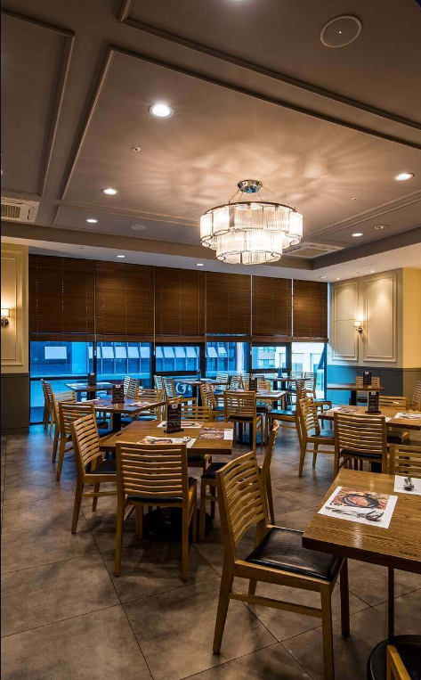
AGENDA
In this presentation, we will cover the following topics:
- The problem statement of sentimental analysis of restaurant reviews.
- An overview of the project and its goals
- Identification of the end users of this project.
- Our solution and its value proposition.
- How we customized the project to make it our own.

Slide 4

PROJECT OVERVIEW
Our project focuses on sentiment analysis of restaurant reviews. The goal is to provide a tool for restaurant owners to understand how their customers feel about their dining experience. By analyzing the sentiment of customer reviews, restaurant owners can make informed decisions about menu items, service quality, and overall customer satisfaction.
2) To achieve this, we have built a machine learning model that can accurately classify restaurant reviews as positive, negative, or neutral. The model takes into account various factors such as the tone of the review, the language used, and the overall context. We have also developed a user-friendly dashboard where restaurant owners can view the sentiment analysis results and track changes over time.

Slide 5
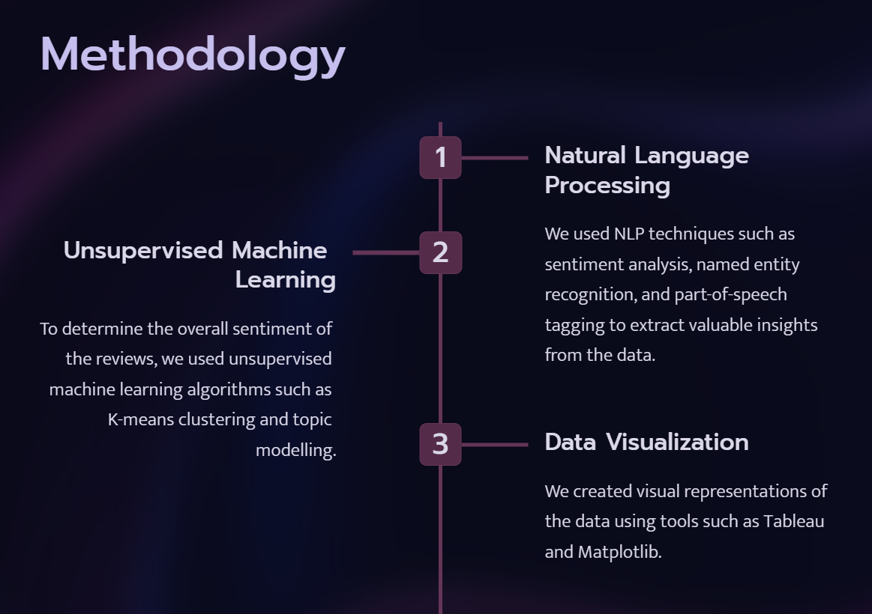

Slide 6


THE END USERS OF THIS PROJECT
The end users of this project are primarily restaurant owners and managers who want to improve their business by analyzing customer reviews. They can use the sentiment analysis tool to identify common themes in positive and negative reviews, and make changes to their menu, service, or ambiance accordingly.
Another potential user group is market researchers who want to study consumer behavior and preferences in the food industry. By analyzing large volumes of restaurant reviews, they can gain insights into trends, popular dishes, and customer satisfaction levels.

Slide 7


SOLUTION AND ITS VALUE PROPOSITION
Our solution for sentiment analysis of restaurant reviews is based on a combination of natural language processing and machine learning algorithms. By analyzing the sentiment expressed in customer reviews, our solution helps restaurants to improve their overall customer experience and identify areas for improvement.
2) Our value proposition lies in the ability to provide actionable insights to restaurant owners and managers, allowing them to make data-driven decisions that can lead to increased customer satisfaction and loyalty. Additionally, our solution is customizable to meet the specific needs of each restaurant, ensuring that they receive the most relevant and useful information.

Slide 8

UNIQUENESS & CUSTOMIZATION
In customizing this project,
we focused on enhancing the accuracy of sentiment analysis by incorporating domain-specific features such as food-related terminology, restaurant names, and location data. This not only improved the precision of our model but also helped us identify key trends in customer sentiment towards specific dishes and restaurants.
Additionally, we added a feature that allows users to filter reviews based on various criteria such as cuisine type, price range, and location. This provides a more personalized experience for users who are looking for specific information about restaurants in their area or those who have dietary restrictions.

Slide 9

WOW IN SYSYEM
Decision Making
Management
Competitive Analysis
Optimization
Feedback Analysis
Productive Scaling
Customer Engagement

Slide 10
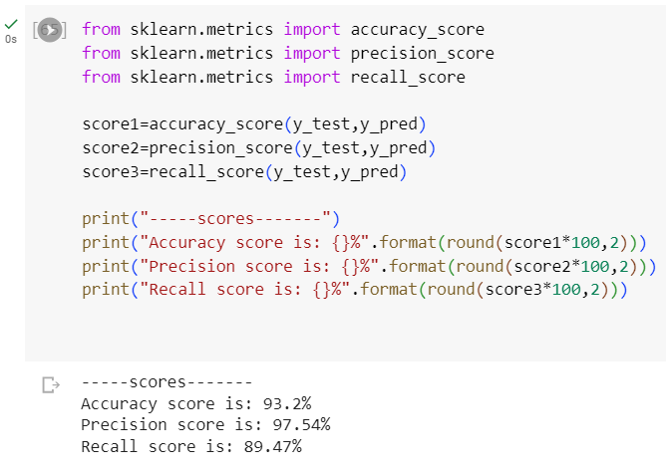
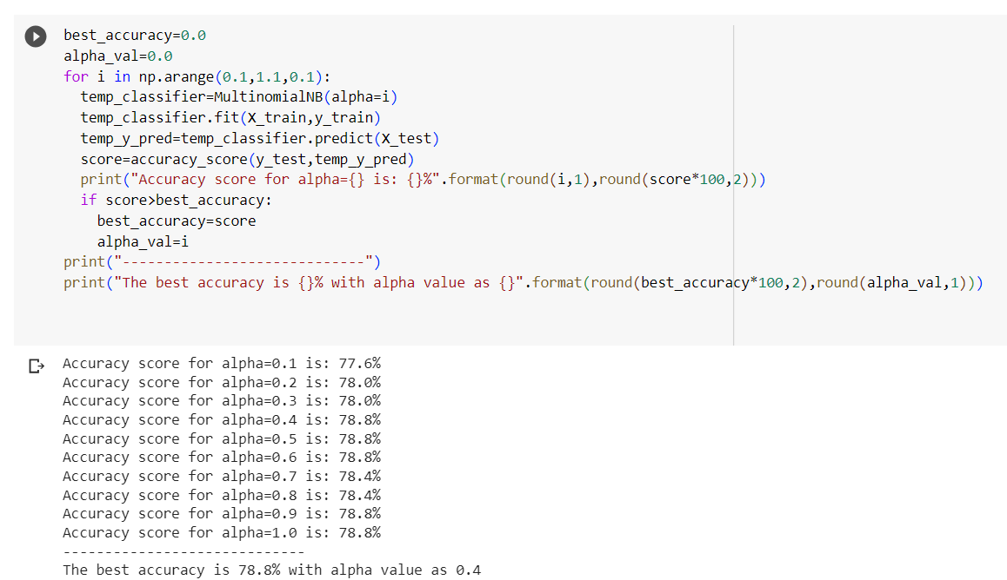
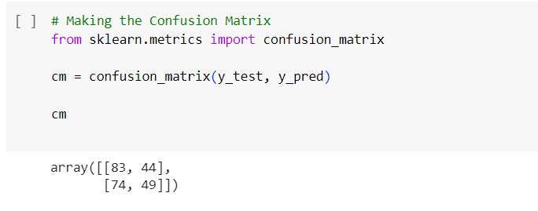
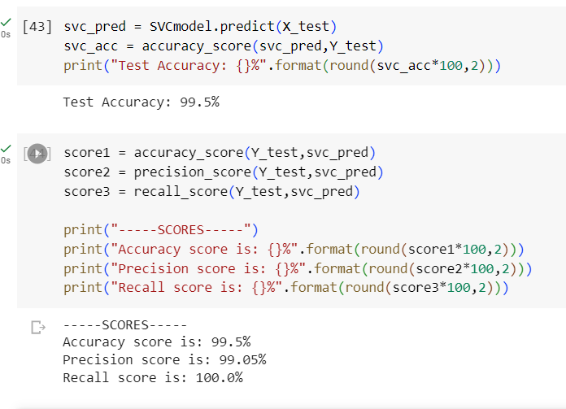
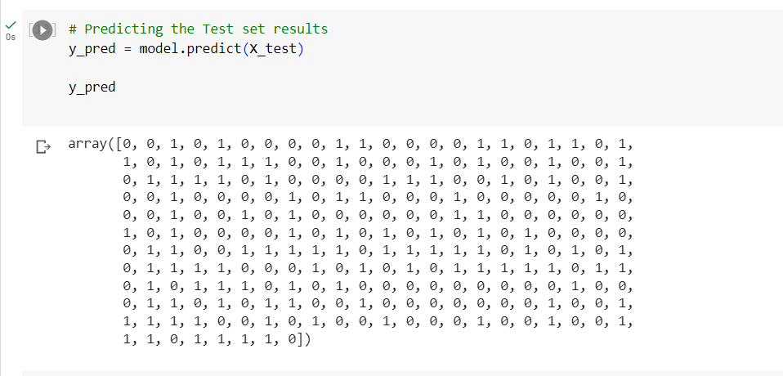
MODELLING
RANDOM FOREST
NAIVE BAYES
CONFUSION MATRIX
SVM
PREDICTING THE TEST RESULTS

Slide 11

RESULT
The results of sentiment analysis can vary in complexity, from simple positive/negative classification to more nuanced sentiment scores that measure the intensity of sentiment. The accuracy of sentiment analysis depends on the quality of the data and the sophistication of the algorithms used. The accuracy also helps us to understand customer feedback in a better way. The results of a restaurant review can vary widely depending on the individual's experience and their assessment of various aspects of the restaurant. It's important to keep in mind that restaurant reviews are subjective and reflect the personal preferences and experiences of the reviewer.

Slide 12
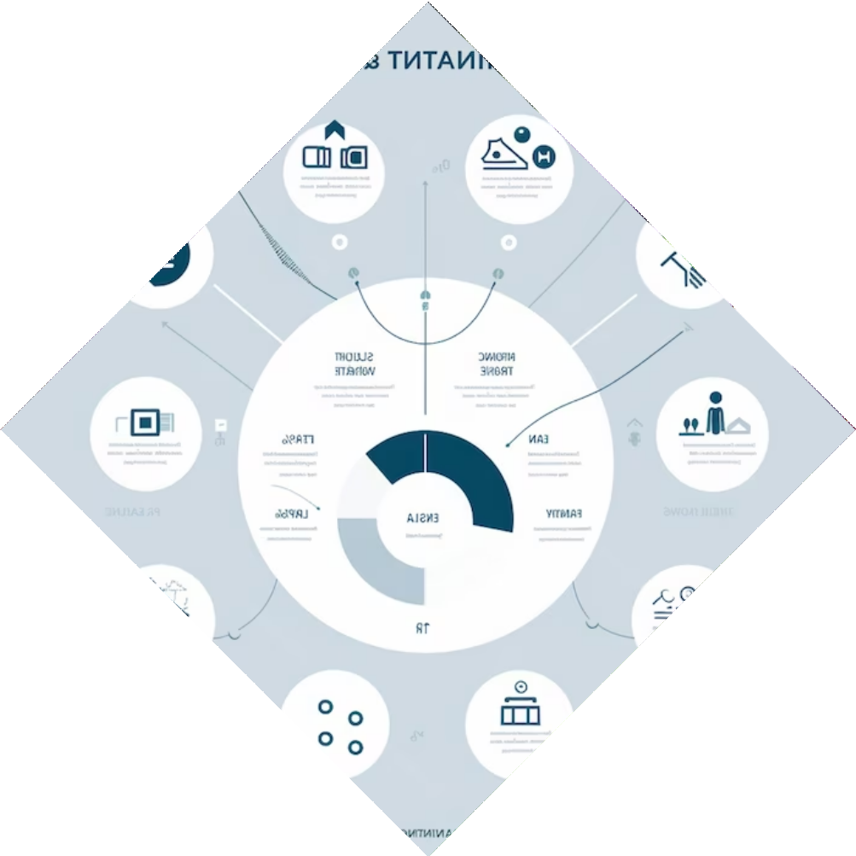
LINKS
Project Source code :
https://colab.research.google.com/drive/1H3-XTcnfLWssruy0kKENFH6izhWnvprE

Slide 13
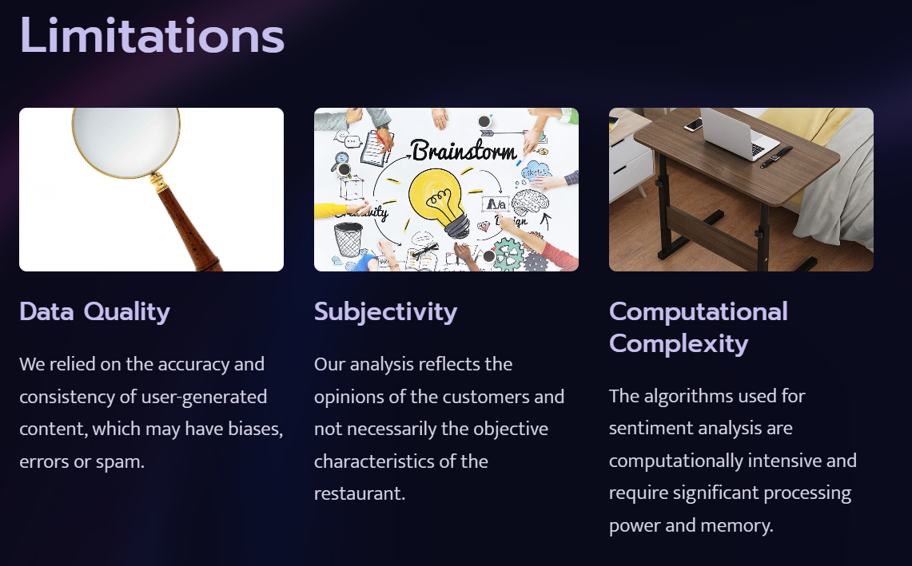

Slide 14


Slide 15
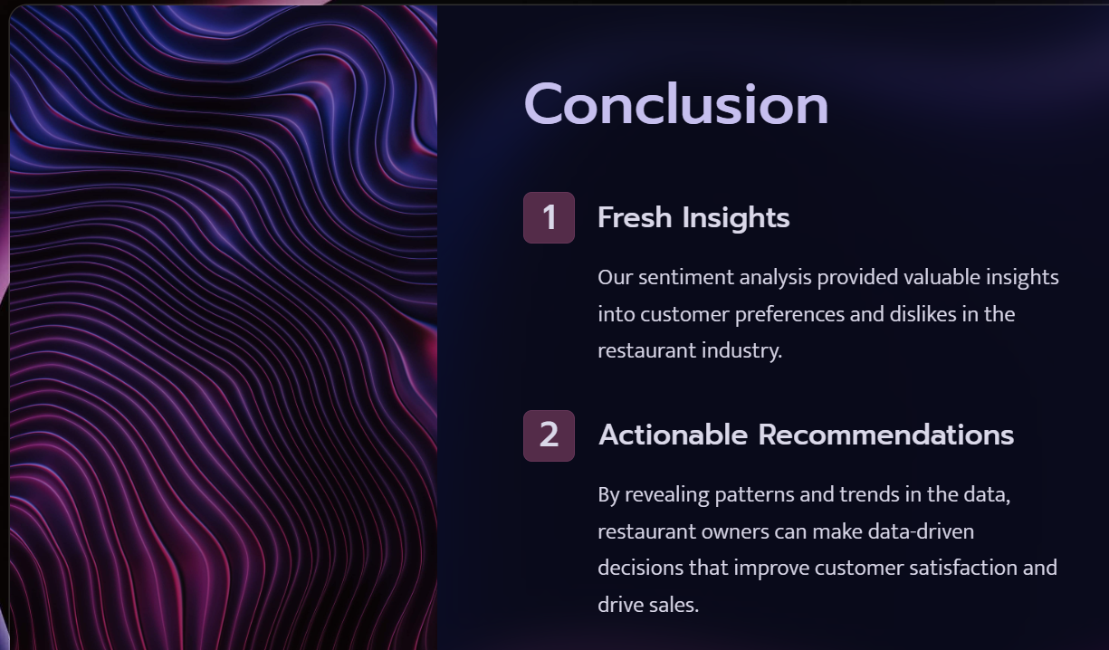

Slide 16


